Slide 1

Geometry
Unit 8, Lesson 3 Special Parallelograms Volume 2, pg. 19

Slide 2


Benchmarks
MA.912.GR.1.4
Prove relationships and theorems about parallelograms. Solve mathematical and real-world problems involving postulates, relationships, and theorems of parallelograms.
MA.912.LT.4.10
Judge the validity of arguments and give counterexamples to disprove statements.
volume 2, pg. 19

Slide 3
Integrated Mathematical Thinking and Reasoning Standards
MA.K12.MTR.1.1 Actively participate in effortful learning both individually and collectively.
MA.K12.MTR.2.1 Demonstrate understanding by representing problems in multiple ways.
MA.K12.MTR.4.1 Engage in discussions that reflect on the mathematical thinking of self and others.
MA.K12.MTR.5.1 Use patterns and structure to help understand and connect mathematical concepts.
volume 2, pg. 19

Slide 4

Learning Targets
I can prove rectangles are parallelograms.
I can use properties of parallelograms to identify special parallelograms.
volume 2, pg. 19

Slide 5

Warm-Up
volume 2, pg. 19

Slide 6
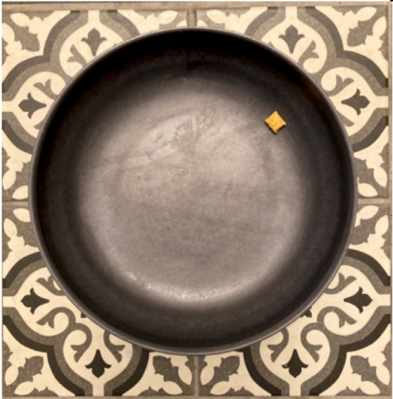
8.3.1 Warm-Up: Estimation
A picture of a bowl with a cereal square is shown.
Estimate the number of cereal squares that will go around the inner circumference of the bowl.
volume 2, pg. 19

Slide 7
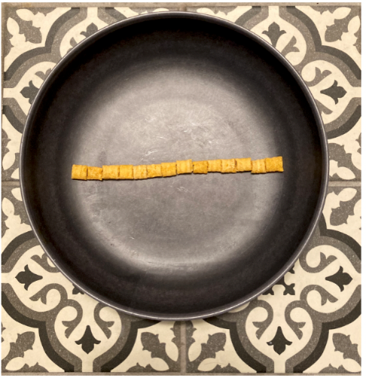
A picture of the bowl with a diameter of cereal squares is shown.
Use the diameter of cereal squares to find the circumference.
Compare your estimate to the circumference found using the diameter of cereal squares.
volume 2, pg. 19

Slide 8

Collaboration
volume 2, pg. 20

Slide 9

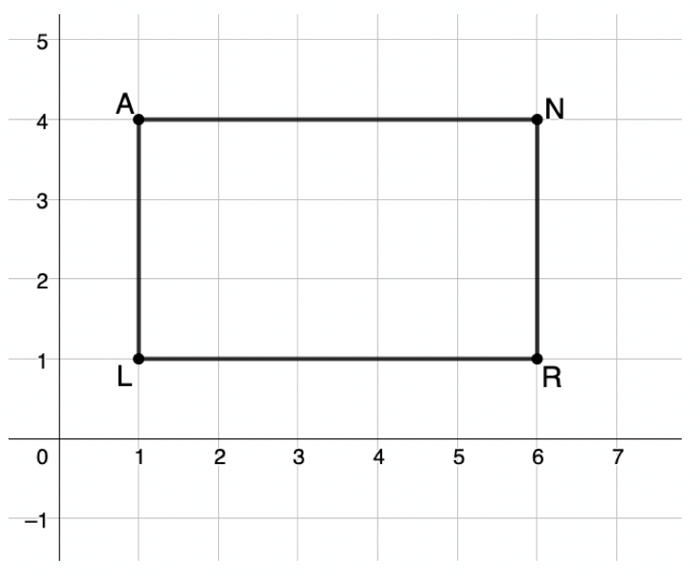
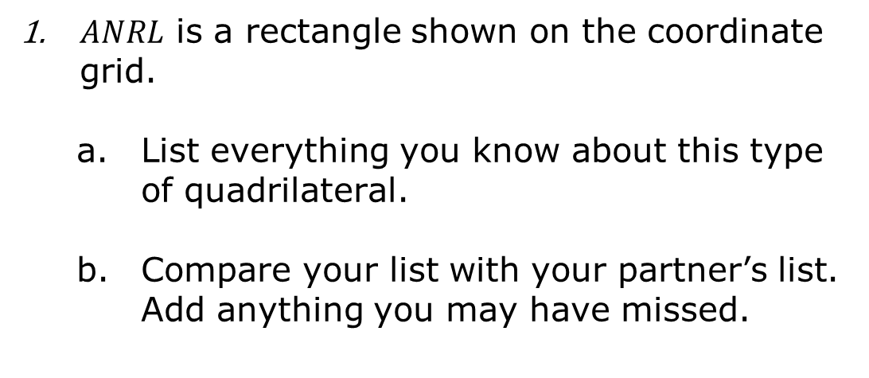
8.3.2 Collaboration: What is a Rectangle?
$ANRL$ is a rectangle shown on the coordinate grid.
List everything you know about this type of quadrilateral.
Compare your list with your partner’s list. Add anything you may have missed.
volume 2, pg. 20

Slide 10
With your partner, list two truths and one lie about this type of quadrilateral in the table below. Share your list with another pair. See if they can spot the lie.
1.
2.
3.
volume 2, pg. 20

Slide 11
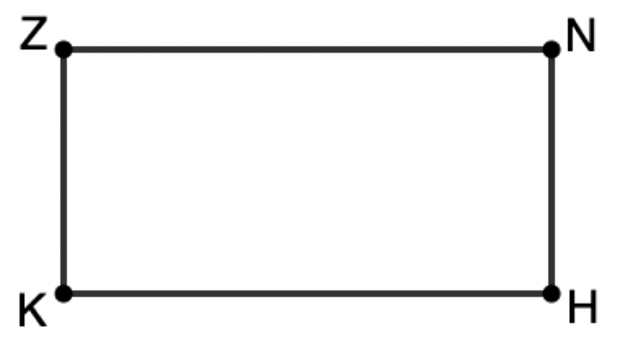

$ZNHK$ is shown.
Using a ruler, draw $\overline{ZH}$ and $\overline{KN}$.
These segments are called ______________.
volume 2, pg. 20

Slide 12
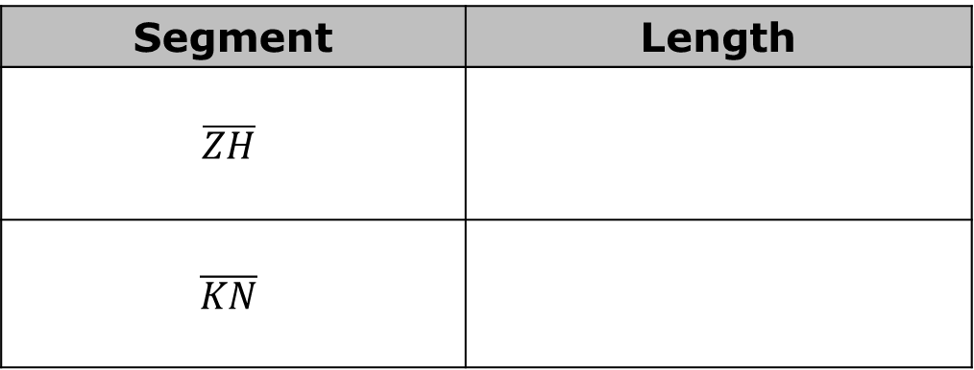

Measure the length of these segments and write them in the table below. Include units.
Make a conjecture about the lengths of the diagonals of a rectangle.
Label the intersection point of the diagonals $S$.
Segment | Length
$$\overline{ZH}$$
$$\overline{KN}$$
volume 2, pg. 21

Slide 13
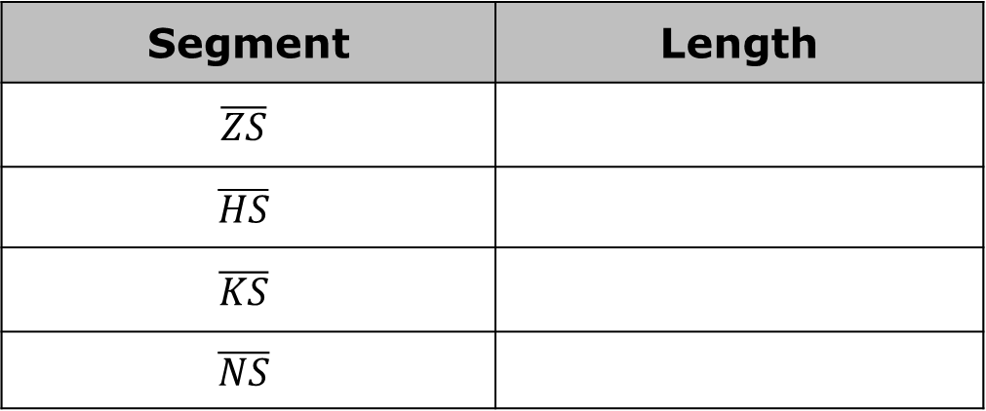
Measure the following segments and fill in their length in the table below. Include units.
What do you notice?
Make a conjecture about what happens to the diagonals of a rectangle when they intersect.
Segment | Length
$$\overline{ZS}$$
$$\overline{HS}$$
$$\overline{KS}$$
$$\overline{NS}$$
volume 2, pg. 21

Slide 14

Exploration
volume 2, pg. 21

Slide 15

8.3.3 Exploration: Comparing Parallelograms and Rectangles
Work with your partner to fill in the table. If the statement describes a property always true of the shape, mark the box.
Statement | Parallelogram | Rectangle
opposite sides congruent
opposite sides parallel
opposite angles congruent
consecutive angles supplementary
diagonals bisect each other
diagonals are congruent
all angles are congruent
volume 2, pg. 21

Slide 16

Based on the chart, discuss with your partner whether a rectangle could be classified as a parallelogram.
A rectangle is a quadrilateral that contains four right angles. Rectangles may be oblong or square. It’s a member of the following shape classes: polygons, quadrilaterals, trapezoids, parallelograms. Squares form a sub- class.
volume 2, pg. 21

Slide 17
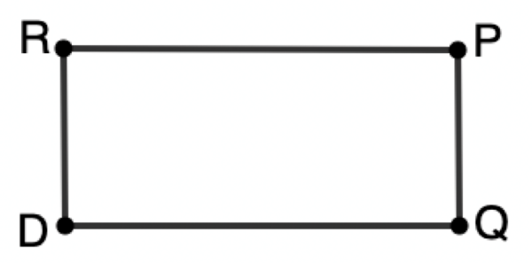
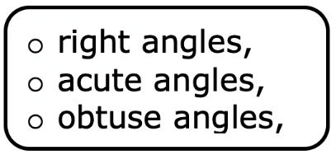
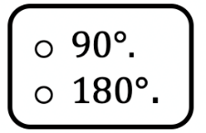
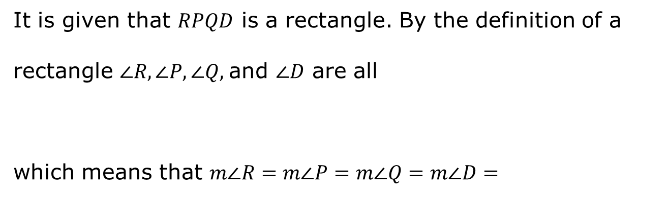
$RPQD$ is a rectangle.
Complete the statements.
It is given that $RPQD$ is a rectangle. By the definition of a
rectangle $∠R, ∠P, ∠Q,$and $∠D$ are all
which means that $m∠R=m∠P=m∠Q=m∠D=$
volume 2, pg. 22

Slide 18
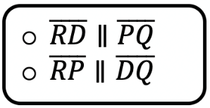
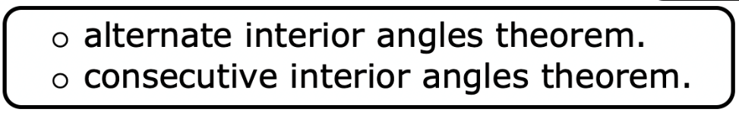
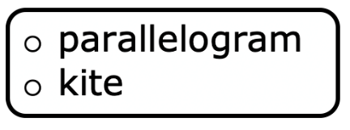

Since $m∠P+m∠Q=180°$ we can show that
and since $m∠D+m∠Q=180°$ we can show that
by the
Therefore, $RPQD$ is a by definition.
volume 2, pg. 22

Slide 19

Guided Instruction
volume 2, pg. 22

Slide 20
8.3.4 Guided Instruction: More Special Parallelograms
A square is a quadrilateral with four right angles and four equal-length sides. It’s a member of the following shape classes: polygons, quadrilaterals, trapezoids, parallelograms, rectangles, rhombi.
volume 2, pg. 22

Slide 21
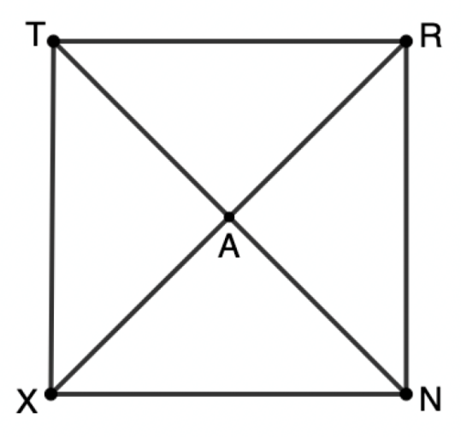
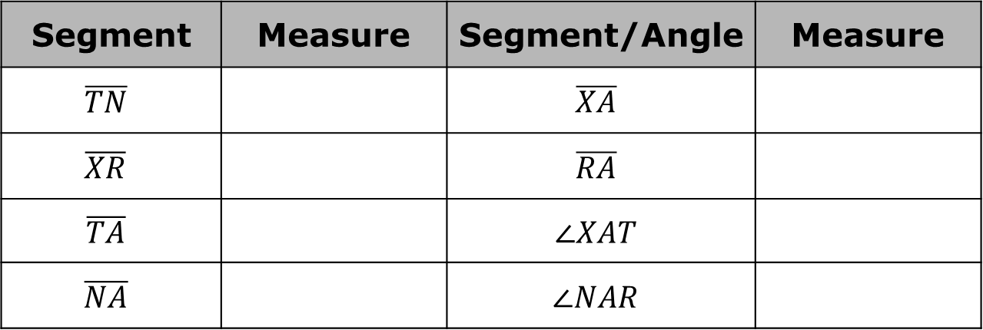
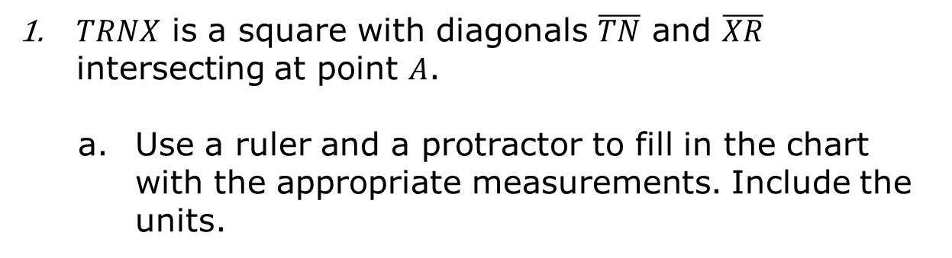
$TRNX$ is a square with diagonals $\overline{TN}$ and $\overline{XR}$ intersecting at point $A$.
Use a ruler and a protractor to fill in the chart with the appropriate measurements. Include the units.
Segment | Measure | Segment/Angle | Measure
$$\overline{TN}$$ |  | $$\overline{XA}$$
$$\overline{XR}$$ |  | $$\overline{RA}$$
$$\overline{TA}$$ |  | $$∠XAT$$
$$\overline{NA}$$ |  | $$∠NAR$$
volume 2, pg. 22

Slide 22
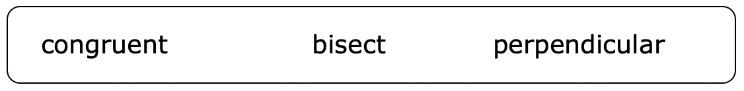
Which of the following describe the diagonals of a square? Circle all that apply.
volume 2, pg. 22

Slide 23
List the features that determine if a parallelogram is a square.
A rhombus is a quadrilateral containing four equal-length sides. It’s a member of the following shape classes: polygons, quadrilaterals, trapezoids, parallelograms. Squares form a sub- class.
volume 2, pg. 23

Slide 24
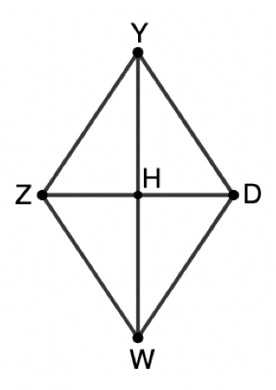
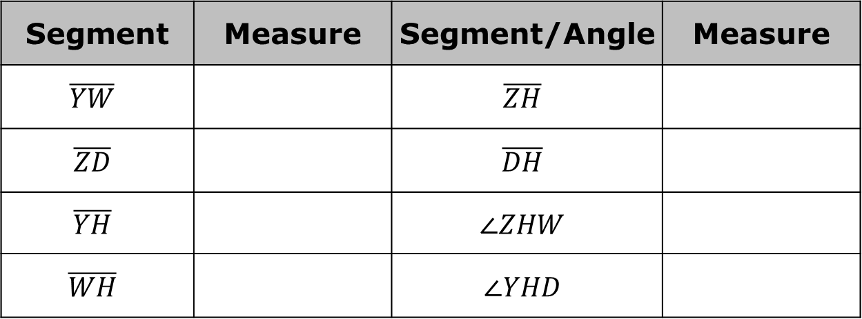
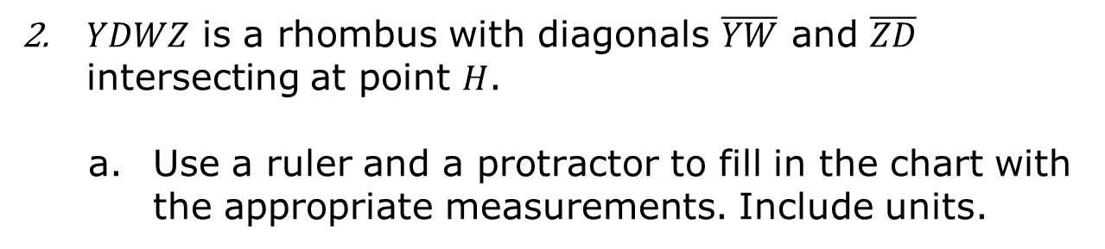
$YDWZ$ is a rhombus with diagonals $\overline{YW}$ and $\overline{ZD}$ intersecting at point $H$.
Use a ruler and a protractor to fill in the chart with the appropriate measurements. Include units.
Segment | Measure | Segment/Angle | Measure
$$\overline{YW}$$ |  | $$\overline{ZH}$$
$$\overline{ZD}$$ |  | $$\overline{DH}$$
$$\overline{YH}$$ |  | $$∠ZHW$$
$$\overline{WH}$$ |  | $$∠YHD$$
volume 2, pg. 23

Slide 25
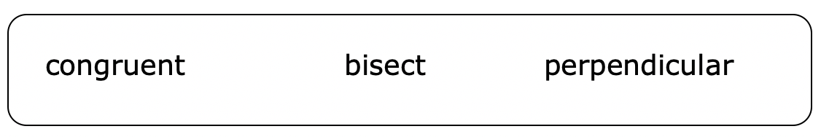
Which of the following describe the diagonals of a rhombus? Select all that apply.
List the features that determine if a parallelogram is a rhombus.
What are the differences between a square and a rhombus?
volume 2, pg. 23

Slide 26
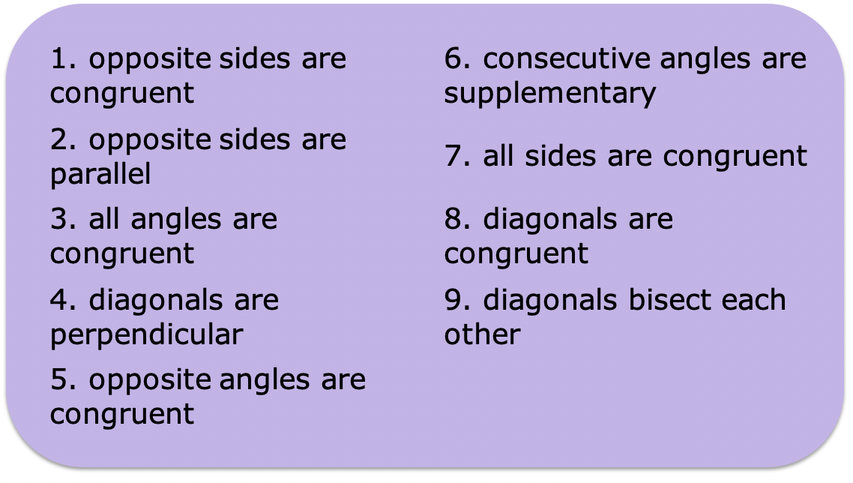
Use the numbered statements in the box to fill in the Venn diagram comparing rectangles, squares, and rhombi.
volume 2, pg. 24

Slide 27
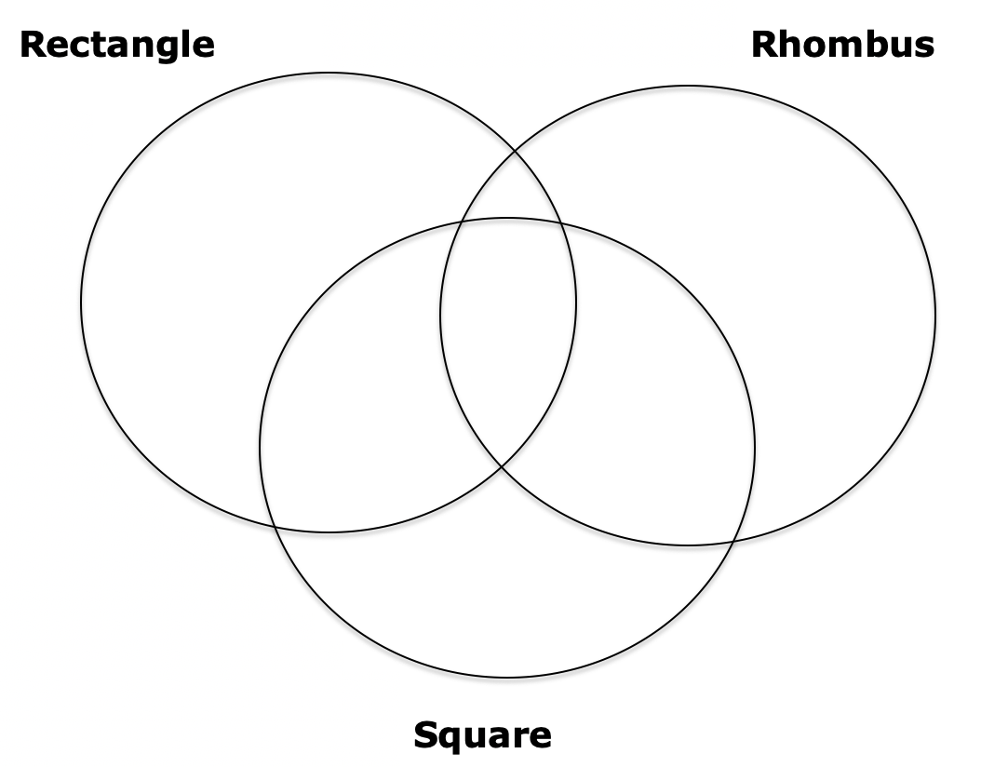
volume 2, pg. 24

Slide 28

Bring It Together
volume 2, pg. 24

Slide 29

8.3.5 Bring It Together: Which Special Parallelogram Is It?
Explain how to show a parallelogram is a rectangle but not a rhombus or a square.
Explain how to show a parallelogram is a rhombus but not a square or a rectangle.
Explain how to show a parallelogram is a square but not a rectangle or a rhombus.
volume 2, pg. 24

Slide 30

Wrap-Up
volume 2, pg. 25

Slide 31
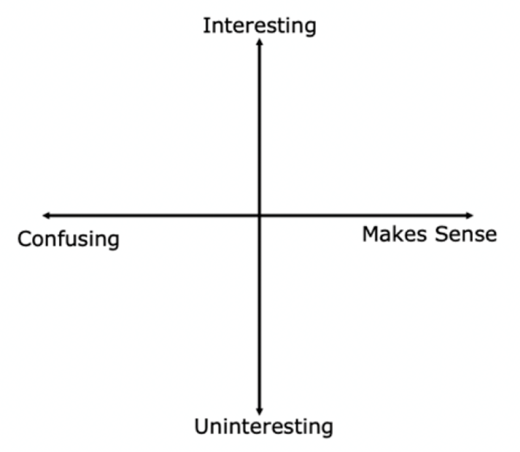
8.3.6 Wrap-Up: Reflection
Plot a point on the grid to indicate your level of interest and how much sense you made of today’s learning targets.
Explain why you placed the point where you did.
volume 2, pg. 25

